Slide 1
Module 10 – Roles of Stakeholders
Training Modules for Applying the Mitigation Hierarchy:
Planning Policy and Projects for No Net Loss or a Net Gain of Biodiversity
Module 10
Stakeholders and their roles and responsibilities

Slide 2
Module on Roles of Stakeholders - Contents
Contents | Slides
Who are the principal stakeholders in a national BNG/NNL system and what are their roles and responsibilities? | 4-5
Companies: different roles, setting the scope of effort, mitigation for an individual project, at the corporate level, through the value chain, and through investment strategy | 6-13
Governments: different roles, key issues at national and project levels | 14-19
Financial institutions: mapping portfolios; engagement, investment strategy and other approaches | 20-24
Communities: key issues and roles | 25-28
NGOs and research institutions: roles | 29-30
Take home messages | 31

Slide 3
Module on Roles of Stakeholders - Abstract
Delivering Biodiversity Net Gain/No Net Loss needs contributions by a range of different stakeholders. This module explores who are the principal stakeholders in a national BNG/NNL system and what are their roles and responsibilities. It covers companies (those with footprints and those undertaking impact assessments and providing mitigation including offsets), describing their roles.
The module sets out the many different roles that governments can play at national and project levels, from regulator to buyer and seller of offsets.
It explores the growing role of financial institutions in working towards BNG/NNL, and runs through the mapping of portfolios as well as engagement, investment strategy and other approaches.
The module sets out key issues and role for communities: holding governments, companies and financial institutions to account, building coalitions for engagement and supporting to companies on mitigation measures and helping shape viable, positive solutions to achieve Biodiversity Net Gain.
NGOs and research institutions can Biodiversity Net Gain, No Net Loss or related goals. They can support policy and practice with good data and science, offer policy and technical advice to governments, companies and banks, and help review and monitor BNG/NNL commitments.

Slide 4
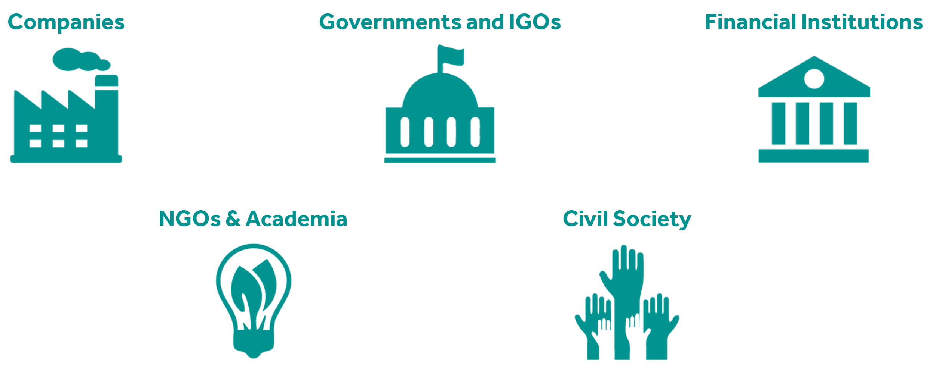
Who are the principal stakeholders in a national BNG/NNL system and what are their roles and responsibilities?
Companies
Government
Intergovernmental organisations
Financial institutions
NGOs and academia
Civil society

Slide 5
Compensation Implementation Roles
Broad Roles
Direction / oversight / management
Field-level activities (on-the-ground conservation)
Monitoring
Financing
Key Stakeholders
Government
Developer
NGOs
Community Groups or Associations
Donors

Slide 6
Stakeholders
Companies
(those with footprints and those undertaking impact assessments and providing mitigation including offsets)

Slide 7
Issues for companies to consider
What are the opportunities and risks in planning for Biodiversity Net Gain?
How do the steps in the Natural Capital Protocol relate to Biodiversity Net Gain?
What are the options for the scope of Biodiversity Net Gain planning, and what approach to take?
How to map and engage stakeholders?
How to develop an internal draft plan for achieving BNG?
How to put the BNG plan into action, once you have a clear vision, scope, and commitment?
How to monitor and evaluate whether you are on track to achieve defined objectives?
How to update internal & external assurance and reporting?
https://www.forest-trends.org/bbop/bbop-for-companies/how-to-plan-for-biodiversity-net-gain/
Notes:
Government is faced with a broad range of potential roles in designing and administering NNL/ NG policies and offsetting systems. Perhaps most obviously, it is the policy-maker and regulator, a role in which it must weigh up the risks and opportunities of policy options and take into consideration the views of stakeholders as to the desirability and nature of NNL/NG policies. Government can also be the provider, curator and source of authoritative biodiversity data, a buyer and seller of offsets, a broker helping developers needing offsets to find the individuals, communities and organizations that can supply them, and the operator of the registry of credits. Government has an important role in setting standards for the various activities within the system (particularly assessment of mitigation measures, loss-gain calculations, biodiversity offset management plans, and generation of biodiversity credits by third parties). Government is also responsible for the processes that ensure the permanence of mitigation measures. A vital role of government is as monitor and enforcer of NNL/NG policy and of developers’ and offset providers’ individual project commitments under this policy. It also falls to government to decide how to allocate and manage land title.
Finally, if policy is to encourage third-party individuals, communities and organizations to generate and supply offsets, government has certain functions in stimulating and regulating the market.
Given this variety of roles, probity is vital, and government must identify and manage potential conflicts of interest between these roles.
For example: The government as a developer of infrastructure projects (needing compensation/offsets) and as the regulator (specifying and enforcing requirements for biodiversity offsets).
How to avoid and manage potential conflicts of interest? Key approaches include:
Good and transparent governance for consistency and accountability.
Independent evaluation of mitigation measures and offsets/compensation, e.g. independent committees appointed by government and/or systems of accreditation of independent verifiers
Coordinated, clear guidance and processes
Prepare a ‘Probity Plan’ in advance: When COI could arise, how to be handled, who is responsible for resolving it, processes to follow.

Slide 8
Different roles of companies
Companies’ roles with respect to BNG include:
Offering comments during stakeholder consultation when government develops policy related to BNG
Developing individual projects that aim to demonstrate BNG
Making corporate commitments and corporate governance systems related to BNG
Notes:
Government is faced with a broad range of potential roles in designing and administering NNL/ NG policies and offsetting systems. Perhaps most obviously, it is the policy-maker and regulator, a role in which it must weigh up the risks and opportunities of policy options and take into consideration the views of stakeholders as to the desirability and nature of NNL/NG policies. Government can also be the provider, curator and source of authoritative biodiversity data, a buyer and seller of offsets, a broker helping developers needing offsets to find the individuals, communities and organizations that can supply them, and the operator of the registry of credits. Government has an important role in setting standards for the various activities within the system (particularly assessment of mitigation measures, loss-gain calculations, biodiversity offset management plans, and generation of biodiversity credits by third parties). Government is also responsible for the processes that ensure the permanence of mitigation measures. A vital role of government is as monitor and enforcer of NNL/NG policy and of developers’ and offset providers’ individual project commitments under this policy. It also falls to government to decide how to allocate and manage land title.
Finally, if policy is to encourage third-party individuals, communities and organizations to generate and supply offsets, government has certain functions in stimulating and regulating the market.
Given this variety of roles, probity is vital, and government must identify and manage potential conflicts of interest between these roles.
For example: The government as a developer of infrastructure projects (needing compensation/offsets) and as the regulator (specifying and enforcing requirements for biodiversity offsets).
How to avoid and manage potential conflicts of interest? Key approaches include:
Good and transparent governance for consistency and accountability.
Independent evaluation of mitigation measures and offsets/compensation, e.g. independent committees appointed by government and/or systems of accreditation of independent verifiers
Coordinated, clear guidance and processes
Prepare a ‘Probity Plan’ in advance: When COI could arise, how to be handled, who is responsible for resolving it, processes to follow.

Slide 9
Companies: considering scope of effort for BNG
How to consider Biodiversity Net Gain (or a similar goal) for different scopes of activity, namely:
for individual operations at the site or project level
at the corporate level for the company’s direct footprint and through the company’s value chain;
for financial institutions, through investment strategy and engagement
Notes:
https://www.forest-trends.org/bbop/bbop-for-companies/how-to-plan-for-biodiversity-net-gain/

Slide 10
Companies: mitigation for an individual project
How to plan an individual site or project for Biodiversity Net Gain?
How to design mitigation measures, including biodiversity offsets? (Next slide…..)
How to ensure that people are left no worse off (in terms of their biodiversity values) as a result of a project and its mitigation measures, including offsets?
How to put in place financial, legal and institutional arrangements for the long-term success of mitigation measures, in particular for offsets?
Notes:
https://www.forest-trends.org/bbop/bbop-for-companies/planning_site_level_bng/

Slide 11
How to design mitigation for an individual project
How to design mitigation measures, including biodiversity offsets, for an individual site or project ?
What are the key steps to take?
Should the process of designing biodiversity offsets be integrated with impact assessment, and how?
Why and how to identify stakeholders and engage them in the design and implementation of biodiversity offsets.
When are biodiversity offsets not appropriate as some impacts cannot be offset?
How to approach the calculation of losses and gains, in working towards NNL/NG?
How can a natural capital account be used to monitor whether a net gain of biodiversity is achieved? And to put a value on the wider environmental, societal and economic co-benefits of doing so?
How to understand issues around stacking and bundling of ecosystem services and biodiversity? How to maximize the benefits and limit the risks when compensating for multiple overlapping ecosystem goods and services (e.g. related to water, carbon, biodiversity)?

Slide 12
Companies: examples of firms working with BNG or similar goals can be found in…..
Technical Notes to Business Roadmap (many examples from companies here)
Business Roadmap (examples from companies here)
Case studies, e.g.:
The Ecological Offset on the BPL HSL, a French Linear Railway Infrastructure. Eiffage, France – A Case Study (2018)
Ambatovy Project, nickel mine, Madagascar (2014) and Ambatovy Project (2009)
Solid Energy, Strongman coal mine, New Zealand (2014) and Strongman (2009)
Ango American Biodiversity Offset Case Study – 2009
Bainbridge Biodiversity Offset Case Study – 2009
Newmont Mining Biodiversity Offset Case Study – 2009
Non-BBOP Compensatory Conservation Case Studies – 2009
Webinars …. And many more examples can be found in the BBOP Library
Notes:
https://www.forest-trends.org/bbop/bbop-for-companies/examples-of-biodiversity-net-gain/

Slide 13
Companies: Quality Management System for BNG
How to plan for BNG using the Plan-Do-Check-Act Cycle in the ISO 9001 Quality Management System?
What are the opportunities and risks in planning for Biodiversity Net Gain?
How do the steps in the Natural Capital Protocol relate to Biodiversity Net Gain?
What are the options for the scope of Biodiversity Net Gain planning, and what approach to take?
How to map and engage stakeholders?
How to develop an internal draft plan for achieving BNG?
How to put the BNG plan into action, once you have a clear vision, scope, and commitment?
How to monitor and evaluate whether you are on track to achieve defined objectives?
How to update internal & external assurance and reporting?
Notes:
https://www.forest-trends.org/bbop/bbop-for-companies/how-to-plan-for-biodiversity-net-gain/

Slide 14
Stakeholders
Governments

Slide 15
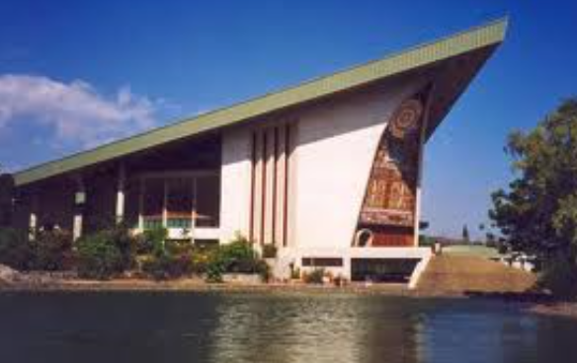
Different roles of government
Government has many potential roles with respect to NNL. These include:
Policy-maker
Provider, curator and source of authoritative biodiversity information
Decision-maker on allocation of land
Buyer of offsets
Seller of offsets
Broker
Operator of register of credits, standard setter
Provider of the process to ensure permanence of offsets
Monitor and enforcer
Notes:
Government is faced with a broad range of potential roles in designing and administering NNL/ NG policies and offsetting systems. Perhaps most obviously, it is the policy-maker and regulator, a role in which it must weigh up the risks and opportunities of policy options and take into consideration the views of stakeholders as to the desirability and nature of NNL/NG policies. Government can also be the provider, curator and source of authoritative biodiversity data, a buyer and seller of offsets, a broker helping developers needing offsets to find the individuals, communities and organizations that can supply them, and the operator of the registry of credits. Government has an important role in setting standards for the various activities within the system (particularly assessment of mitigation measures, loss-gain calculations, biodiversity offset management plans, and generation of biodiversity credits by third parties). Government is also responsible for the processes that ensure the permanence of mitigation measures. A vital role of government is as monitor and enforcer of NNL/NG policy and of developers’ and offset providers’ individual project commitments under this policy. It also falls to government to decide how to allocate and manage land title.
Finally, if policy is to encourage third-party individuals, communities and organizations to generate and supply offsets, government has certain functions in stimulating and regulating the market.
Given this variety of roles, probity is vital, and government must identify and manage potential conflicts of interest between these roles.
For example: The government as a developer of infrastructure projects (needing compensation/offsets) and as the regulator (specifying and enforcing requirements for biodiversity offsets).
How to avoid and manage potential conflicts of interest? Key approaches include:
Good and transparent governance for consistency and accountability.
Independent evaluation of mitigation measures and offsets/compensation, e.g. independent committees appointed by government and/or systems of accreditation of independent verifiers
Coordinated, clear guidance and processes
Prepare a ‘Probity Plan’ in advance: When COI could arise, how to be handled, who is responsible for resolving it, processes to follow.

Slide 16
Conflict of interest
Given the variety of government roles, government must identify and manage potential conflicts of interest between the different roles.
For example: The government as a developer of infrastructure projects (needing compensation/offsets) and as the regulator (specifying and enforcing requirements for biodiversity offsets).
How to avoid and manage potential conflicts of interest? Key approaches include:
Good and transparent governance for consistency and accountability.
Independent evaluation of mitigation measures and offsets/compensation, e.g. independent committees appointed by government and/or systems of accreditation of independent verifiers
Coordinated, clear guidance and processes
Prepare a ‘Probity Plan’ in advance: When COI could arise, how to be handled, who is responsible for resolving it, processes to follow.
Notes:
Potential conflicts of interest do not necessarily mean that governments cannot undertake a variety of roles relating to mitigation, including biodiversity offsets/compensation. However they mean that potential conflicts need to be identified and arrangements put in place to manage and resolve conflicts as they arise. This process is sometimes referred to as ‘probity’. Probity is a feature of the design and implementation of an offset system by government that is concerned with integrity in the process and ensuring that all parties are treated with fairness and equity, in a system with good governance.
Probity involves an examination of the processes involved in the various roles, describing and separating responsibilities and identifying issues including conflicts of interest, confidentiality, information handling and decision-making. Usually a probity plan is prepared by an independent probity adviser that sets out in advance how these issues will be handled. Measures included in probity plans include the clear separation of decision-making, secure arrangements for handling information and formal declarations of personal conflicts of interest. The independent probity adviser will generally review operations from time to time and provide a report to the various parties on compliance with the probity principles and the other provisions of the probity plan.
In additional to the points above, which relate to potential conflicts of interest as a result of the distinct roles of government in NNL/NG systems, another type of perceived conflict may arise from how government embeds NNL/NG within public policy. For instance, some would see a conflict between government’s obligation to dedicate public funds to conservation and any ‘cost shifting’, in which the public funding for conservation is reduced because the cost is passed on to private developers through offset requirements.

Slide 17
Governments: Key issues with BNG at the national and project levels
What are the key issues and elements of a national system for ‘Biodiversity Net Gain’, ‘No Net Loss’ or a similar goal?
What are the key issues and approaches for designing a specific project for ‘Biodiversity Net Gain’ or ‘No Net Loss’?
See National System Module XXXX
See No Net Loss/Biodiversity Net Gain Module XXXX
Notes:
https://www.forest-trends.org/bbop/bbop-for-governments-igos/

Slide 18
Governments: Key issues with BNG at the national/state level
Key issues: principal elements and key stages of planning a system for Biodiversity Net Gain
What is a national (or regional) system for ‘Net Gain of biodiversity’ and why can it help?
How does Biodiversity Net Gain planning relate to sustainable development goals?
What are the opportunities and risks in planning for Biodiversity Net Gain?
What are the options for policy goals (e.g. Biodiversity Net Gain, No Net Loss and alternatives?
What are the principal elements of a system for Biodiversity Net Gain?
Why a ‘roadmap’? What are the key stages of planning for BNG/NNL?
What are some key lessons learned from past experience?
Notes:
https://www.forest-trends.org/bbop/bbop-for-governments-igos/key-issues/

Slide 19
The role of donors
Governments, financial institutions and foundations provide financial support to third parties.
When making grants or loans to recipients, government donors can:
Ensure that grants or loans (e.g. funding infrastructure projects or development plans) contain performance standards so these projects and plans aim to follow the mitigation hierarchy and deliver Biodiversity Net Gain.
Provide finance for governments to establish effective mitigation systems to achieve the net gain vision including support for capacity building for both public and private sector entities

Slide 20
Stakeholders
Investors & Donors

Slide 21
With project finance, it is a challenge coordinating three timelines:
Environmental/Biodiversity
Project lifecycle
Financial
Prepare ESIA Scope & Tender
Apply Mitigation Hierarchy & Quantify Residual Impacts
Prepare Offset Design
Screening & Landscape Analysis
Review Potential Offset Locations
Baseline Studies
Project Design & Execution Plan
Construction
Commissioning & Operations
Site Selection
Site Preparation
Credit Approval
1st Disbursement
Financial Close
Annual Monitoring Report
Source: Biodiversity for Banks:
WWF, Citi, EPA, BBOP
Notes:
A particular challenge for the companies, regulators, banks and advisers involved in offset design is to coordinate three processes that tend to have rather different timelines:
The environmental and biodiversity timeline: to understand a project’s impacts on biodiversity and design appropriate mitigation measures, including an offset, it is necessary to have adequate biodiversity data. This can require fieldwork which can be time-consuming, especially if it is important to have data from different seasons. This doesn’t always fit neatly with the project and financial lifecycles.
The project lifecycle: this starts at the pre-feasibility stage and extends to post-closure, often over many decades. It can be challenging to match this up to the environmental and financial project cycles.
The financial timeline: Investors and lenders bring their own requirements (including offset requirements) into the process. Sometimes they are involved from the earliest stages in the project lifecycle, and sometimes they only become involved with the client company once construction has started (and avoidance and minimisation measures can no longer be altered). Another challenge is that the period of time between the first discussions between bank and client (eg discussions which lead a particular bank to be selected as Mandated Lead Arranger and credit approval and financial close is often very short. The Structured Finance Director and Deal Team are often quite unfamiliar with biodiversity issues, including the contents of IFC Performance Standard 6. It may be the job of the environmental specialists in the bank’s Deal Team to explain this to their colleagues, and make the case for baseline work for biodiversity. They may have little time and information as the basis for this.

Slide 22
Financial institutions
How to consider Biodiversity Net Gain (or a similar goal) for financial institutions (FIs), through investment strategy and engagement? Issues:
What’s the business case for FIs to consider BNG in investment strategy and engagement?
What levels of ambition can be set for BNG in investment policy?
How can a footprinting exercise help FIs understand the nature of their impacts on biodiversity?
How can impacts on biodiversity be addressed by FIs through a variety of approaches
Includes Safeguards and Performance Standards, for which see Standards Module
Notes:
The main impact of financial institutions on biodiversity stems from their investment decisions and the impacts of the projects, companies and countries in which they invest. Investments that entail land-use change, carbon emissions and water pollution, for instance, cause a loss of biodiversity. The loss of biodiversity can cause and be associated with financial risk. By way of illustration, when the IOI Group lost its certification under the Round Table for Sustainable Palm Oil and major suppliers stopped sourcing from the company, its share price dropped by 7% and its market capitalisation by 17%. Examples such as this point to the fact that there can be material financial risk and opportunity associated with impacts and dependence on biodiversity. https://www.thestar.com.my/business/business-news/2016/03/29/rspo-suspension-negative-for-ioi-group/
https://www.valuewalk.com/2017/11/ioi-corporation-berhad/ Including BNG in an ESG policy, investment strategy and engagement can drive a clear goal and positive impact through investments, and serve as part of the basis of well-informed investment decisions. BNG can serve as an aspirational goal in the realm of finance and impact investing. Commitment by the board to include BNG in an ESG investment strategy and policy will enable a financial institution to work towards BNG, allocating the necessary resources to doing so.

Slide 23
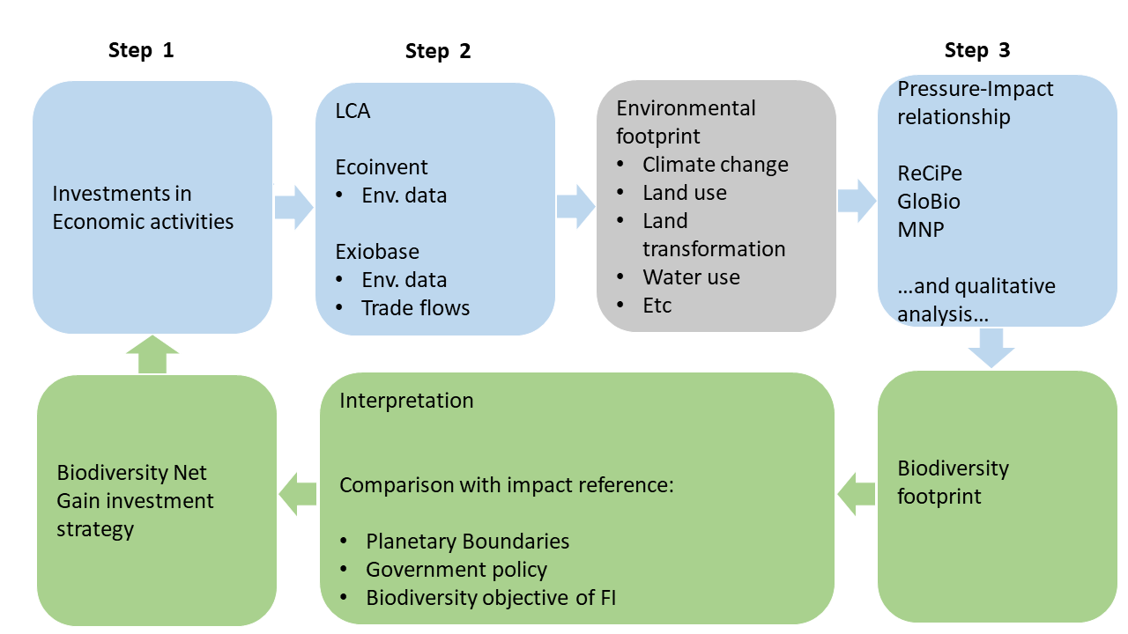
Financial institutions: BNG in investment strategy and engagement decisions – mapping portfolios
Mapping at a portfolio level to understand the footprint of the financial institution (FI) and its investment universe against biodiversity risk and opportunity.
Companies’ exposure to biodiversity risk and opportunity can be used by FIs to define their “high-risk” investments on which to focus and prioritise activity.
Several FIs are reviewing the impacts of the investments in their portfolios on biodiversity.
Notes:
Financial institutions can approach biodiversity with a range of levels of ambition, which can usually be described in terms of the goal set and the scope of activities it covers. The goal can range from very general qualitative formulations such as ‘improving outcomes for biodiversity’ or ‘enhancing biodiversity’ to more specific quantitative commitments to Zero Net Deforestation, No Net Loss, Biodiversity Net Gain (or Net Positive Impact), accompanied by clear definitions, metrics and frames of reference. For instance, in 2017, ASN Bank committed to ‘No net loss of biodiversity as a result of all of our loans and investments by 2030’, and in 2018, raised its level of ambition to a goal of ‘Net Positive Impact’. The scope can range from individual funds to specific asset classes to the whole investment portfolio.
https://www.asnbank.nl/algemeen/duurzaamheid/duurzaamheidsbeleid/biodiversiteit/no-net-loss-of-biodiversity-in-2030.html
A helpful first stage in addressing impacts on biodiversity through investment can be a mapping exercise at a portfolio level in order to understand the footprint of the financial institution and its investment universe against biodiversity risk and opportunity. Financial institutions can review companies’ exposure to biodiversity risk and opportunity (for example, because of operations near to high biodiversity value areas, or particularly high dependence on biodiversity and ecosystem services - for instance, pollination). This can be used to define “high-risk” companies on which to focus and prioritise activity.
A number of financial institutions are developing methodologies and undertaking assessments that reveal the impacts of the investments in their portfolios on biodiversity. Typical steps in such ‘footprinting’ can involve defining the boundary of the economic activities to be investigated as part of the footprint, then collecting data and finally calculating the footprint. An example is the methodology developed by ASN bank, illustrated in Figure 7. Common ground on biodiversity footprinting requirements is now being developed by ASN Bank, ACTIAM, Finance in Motion and CDC Biodiversité, developed in cooperation with CREM and PRé Consultants. For more information, see BBOP Corporate Roadmap Technical Notes/Technical Note 19.

Slide 24
Financial institutions:
different approaches for working towards BNG
Screening: Principles and criteria establish sectors and companies in which to invest or to avoid.
Voting: Using voting rights as shareholders to urge companies to address biodiversity risks and opportunities (and specifically BNG) to become more sustainable.
Engagement: Dialogue with the boards or management of companies in which FIs are invested, to understand and improve their performance on biodiversity.
ESG integration: Consideration of biodiversity in investment decisions.
Safeguards in project finance: defining the environmental and social standards required of projects seeking finance, including BNG.
Favourable loan conditions: lower bank interest rates for companies with a good track record on managing biodiversity risk and opportunity.
Impact Investing: investing in assets to achieve positive social and environmental return as well as a financial return.
Blended finance: Development finance, philanthropic funds (and public/private partnerships) to mobilise private capital to biodiversity-friendly investments.
Notes:
Financial institutions can approach biodiversity with a range of levels of ambition, which can usually be described in terms of the goal set and the scope of activities it covers. The goal can range from very general qualitative formulations such as ‘improving outcomes for biodiversity’ or ‘enhancing biodiversity’ to more specific quantitative commitments to Zero Net Deforestation, No Net Loss, Biodiversity Net Gain (or Net Positive Impact), accompanied by clear definitions, metrics and frames of reference. For instance, in 2017, ASN Bank committed to ‘No net loss of biodiversity as a result of all of our loans and investments by 2030’, and in 2018, raised its level of ambition to a goal of ‘Net Positive Impact’. The scope can range from individual funds to specific asset classes to the whole investment portfolio.
https://www.asnbank.nl/algemeen/duurzaamheid/duurzaamheidsbeleid/biodiversiteit/no-net-loss-of-biodiversity-in-2030.html

Slide 25
Stakeholders
Communities

Slide 26
Communities:
What are the key issues?
Indigenous peoples and local communities play a vital role in the development and implementation of policy, projects and mitigation.
See Stakeholder buy-in and the social component of NNL/BNG.
Information is available to help communities consider and plan their roles:
What is needed to make a real shift towards Biodiversity Net Gain?
Can mitigation measures help my community?
How can my community help ensure governments’ policies and companies’ mitigation measures meet best practice?
How can I help as a citizen?
See Social Issues Module XXXX.
Notes:
Individuals, households and communities value and rely on biodiversity and ecosystem services for their livelihoods and quality of life. They are affected by governments’ policies development and conservation. They can also be affected by specific development projects (e.g. a new road or mine) and any mitigation measures – including biodiversity offsets – put in place to address the projects’ impacts on biodiversity. The knowledge of local communities and indigenous peoples about biodiversity can help set appropriate scientific targets for conservation. Citizens and community groups can help shape policy and also the mitigation measures for specific projects, and be aware of tools to help ensure they are not left any worse off as a result of projects and mitigation measures. They can monitor biodiversity and the results of development and conservation activities to see whether commitments to Biodiversity Net Gain are being met, and they can hold governments, companies and banks to account for their performance
See
https://www.forest-trends.org/bbop/bbop-for-civil-society/help-my-community/
https://www.forest-trends.org/bbop/bbop-for-civil-society/citizen/
….And see Module XXXX

Slide 27
BNG/NNL:
Possible roles for civil society organisations
Hold governments, companies and financial institutions to account for keeping their commitments (e.g. meeting policy and corporate targets) and maintaining high standards.
Build effective coalitions to engage with companies to ensure compliance with mitigation commitments.
Alert society when standards are not met.
Help shape viable, positive solutions to achieve Biodiversity Net Gain.
Enter into partnerships with NGOs, local government, and companies to support best practice.
Review the policies and procedures of governments: See Benchmark & Government Roadmap
Review the policies and procedures of companies and banks: See Standard on Biodiversity Offsets and Business Roadmap

Slide 28
Role of communities
⇒ See the module on SOCIAL ASPECTS XXXX
⇒ The social module covers how to ensure communities are left no worse off (and preferably better) if they are affected by projects and their mitigation measures

Slide 29
Stakeholders
NGOs & Research Institutions

Slide 30
NGOs & research institutions:
important roles for BNG
Policy and practice on BNG relies on science and interaction with social, environmental and research organisations.
NGOs, universities, research institutes, and conservation organisations have skills and expertise vital for working towards Biodiversity Net Gain, No Net Loss or related goals. They can:
Support policy and practice with good data and science, particularly to set appropriate scientific targets for conservation and establish the baselines, exchange rules and metrics.
Offer policy and technical advice to governments, companies and banks. (This may involve partnerships.)
Ensure effective review and monitor whether commitments to Biodiversity Net Gain are being met. Hold governments, companies and banks accountable for their commitments.
Notes:
People working for conservation NGOs (‘non governmental organisations’), and members of universities, research institutes, botanical gardens, herbaria, zoos and aquaria, have skills and expertise vital for working towards Biodiversity Net Gain, No Net Loss or related goals. Their knowledge of biodiversity can help set appropriate scientific targets for conservation and establish the baselines, exchange rules and metrics needed to define government and corporate policies on Biodiversity Net Gain and similar goals. They can advise and enter into partnerships with government agencies and companies to help them develop and apply best practice. They can undertake fieldwork and deliver conservation outcomes on land and in the sea that contribute towards Biodiversity Net Gain. They can undertake monitoring to see whether commitments to Biodiversity Net Gain are being met, and they can help hold governments, companies and banks accountable for their commitments.

Slide 31
Module on Roles of Stakeholders – Take home messages
Delivering Biodiversity Net Gain/No Net Loss relies on contributions by a range of different stakeholders.
Companies working towards BNG/NNL or a similar goal first need to decide on the scope of effort. They should consider mitigation for an individual project, at the corporate level, through the value chain, and (if they are financial institutions) through investment strategy.
Governments can play many roles, including policy-maker, provider, curator and source of authoritative biodiversity information, decision-maker on allocation of land, buyer of offsets, seller of offsets, broker, operator of register of credits, standard setter, provider of the process to ensure permanence of offsets, and monitor and enforcer.
The knowledge of local communities and indigenous peoples about biodiversity can help set appropriate scientific targets for conservation. They can hold governments, companies and financial institutions to account for their commitments, build coalitions for engagement and support companies on mitigation measures as well as helping shape viable, positive solutions to achieve Biodiversity Net Gain.
NGOs and research institutions can support policy and practice with good data and science, offer policy and technical advice to governments, companies and banks, and help review and monitor BNG/NNL commitments.

